Slide 1
Stock Price Prediction
Stacked-LSTM with Attention Mechanism
Haoqi Gu, Junwei Li, Jingyi Li, Fengxu Tu

Slide 2

Task Statement
Stock price prediction has always been a hot but challenging task.
Investors and researchers usually derive a great number of factors from original data such as historical stock price, company profit, or textual data collected from social media.
Various attempts have been made using different kinds of traditional machine learning algorithms. WSVM, ARIMA and NN models.

Slide 3
Related Approaches
ARIMA autoregressive integrated moving average, Xiao et al. (2014)
WSVM, Luo et al. (2017)
Markov decision process and genetic algorithms, Chang and Lee (2017)
Turned textual data collected from social media into vectors and use them as addition features, Ming et al. (2014)

Slide 4
Project Statement
Data
We use the historical stock dataset from Kaggle to train and test our model.
Stocks: SHA, AAPL, AMZN, FB.
Models
LSTM
Stacked-LSTM (2 LSTM layers)
Attention-LSTM
Evaluation
Metrics
Trading strategy

Slide 5
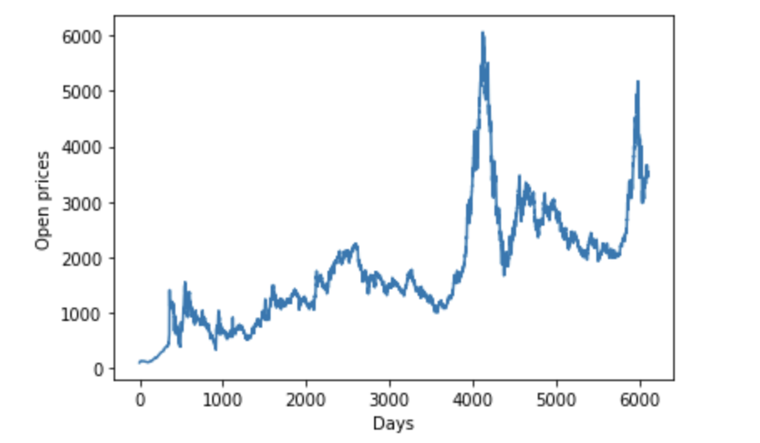
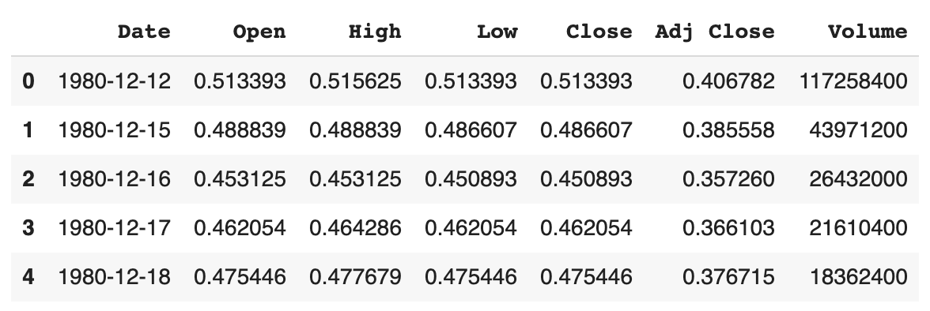
Data
Historical daily information of stocks
Features:
Date: specifies trading date
Open: opening price
High: maximum price during the day
Low: minimum price during the day
Close: close price adjusted for splits
Adj Close: adjusted close price adjusted for both dividends and splits.
Volume: the number of shares that changed hands during a given day
70% samples for training set, 15% for validate set, 15% for testing set

Slide 6
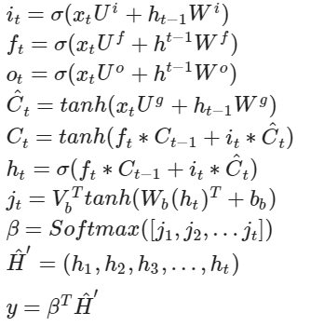
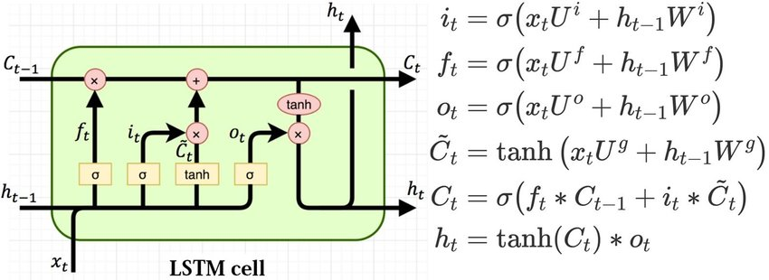
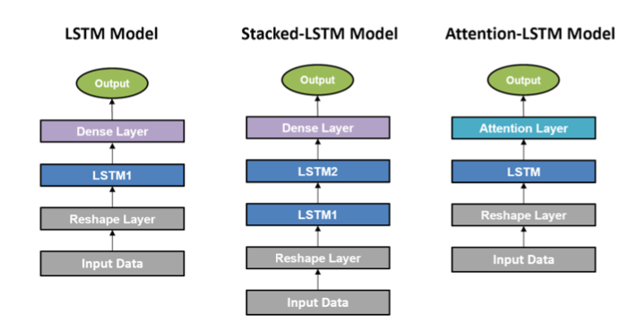
Architecture
LSTM Cell
Models

Slide 7
Parameter Overview
Input Feature Dimension: 6
Open
Close
High
Low
Adj Close
Volume
Stacked-LSTM
Time Series Length: 20
LSTM Layers: 2
Hidden Size: 100
Dropout Rate: 0.2
Batch Size: 64
Output Time Series Length: 1
Optimizer
Adam
Learning rate: 0.0005
Training
Epoches: 200 (with early stop)
Output
Predict Day: 1
Open
Close

Slide 8
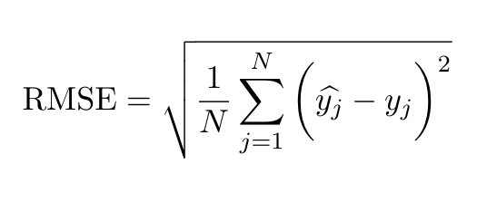
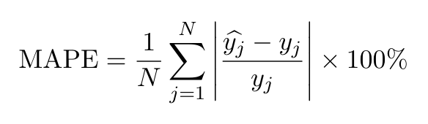
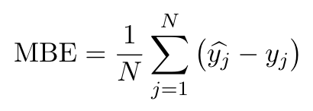
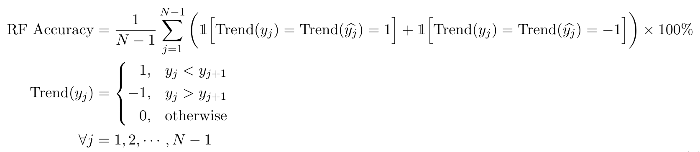
Metrics
Root Mean Square Error (RMSE/RMSD)
Mean Absolute Percentage Error (MAPE)
Mean Bias Error (MBE)
Rise and Fall Accuracy

Slide 9
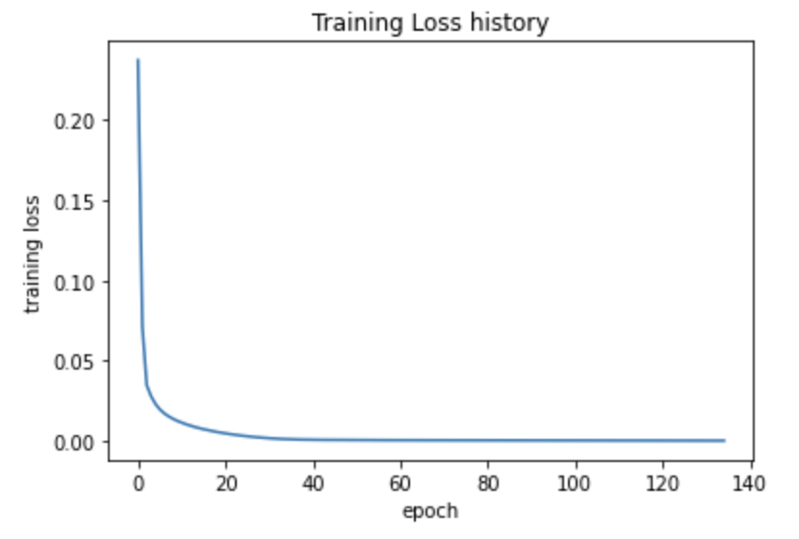
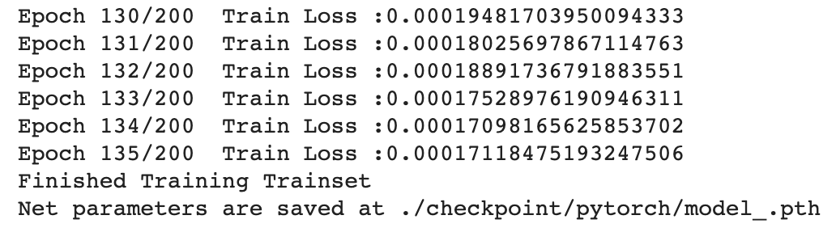
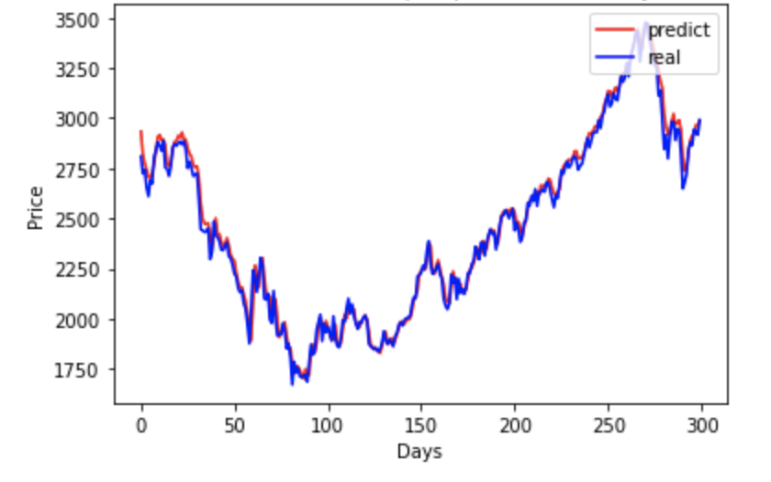
Training Outcome (SHA)
Training loss history
300 days real/predict plot on validation set

Slide 10
Evaluation
Stock price predictions on 3 stocks
Metrics\Stocks | AAPL |  | AMZN |  | FB
 | Open | Close | Open | Close | Open | Close
RMSE | 1.6509 | 1.3135 | 7.3241 | 9.1050 | 4.2690 | 4.2661
MAPE | 1.8718% | 0.6912% | 0.1623% | 0.4505% | 1.7943% | 0.9954%
MAB | 0.9322 | 0.4986 | 0.6719 | -1.2041 | 2.1717 | 2.0651
Rise/Fall Accu. | 55% | 50% | 61% | 51% | 54% | 52%

Slide 11
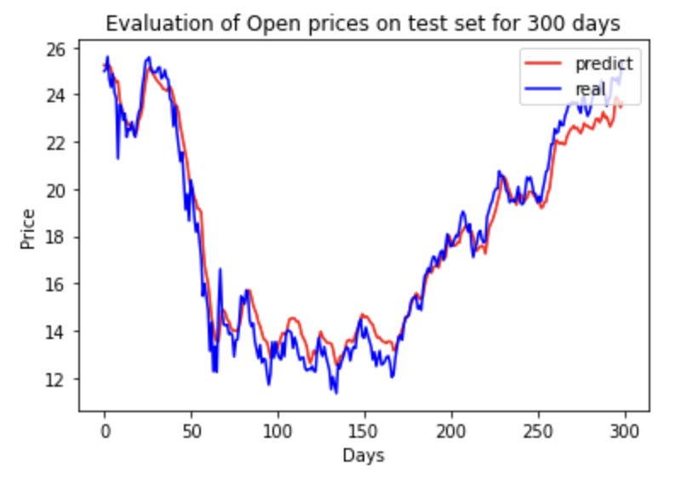
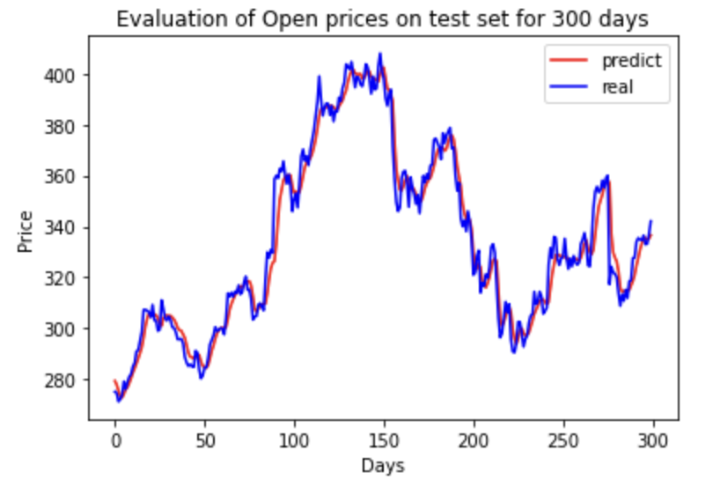
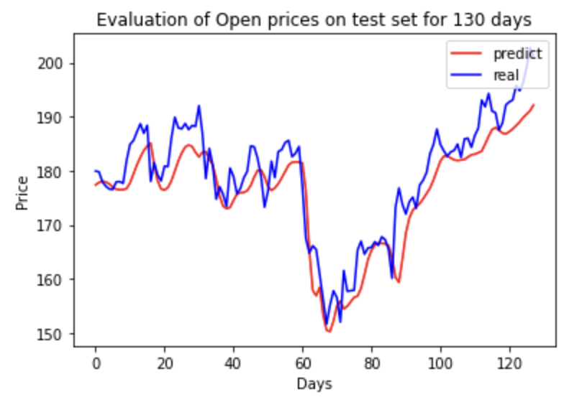
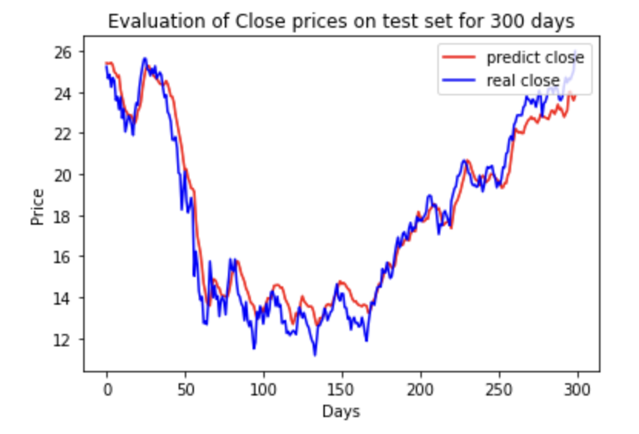
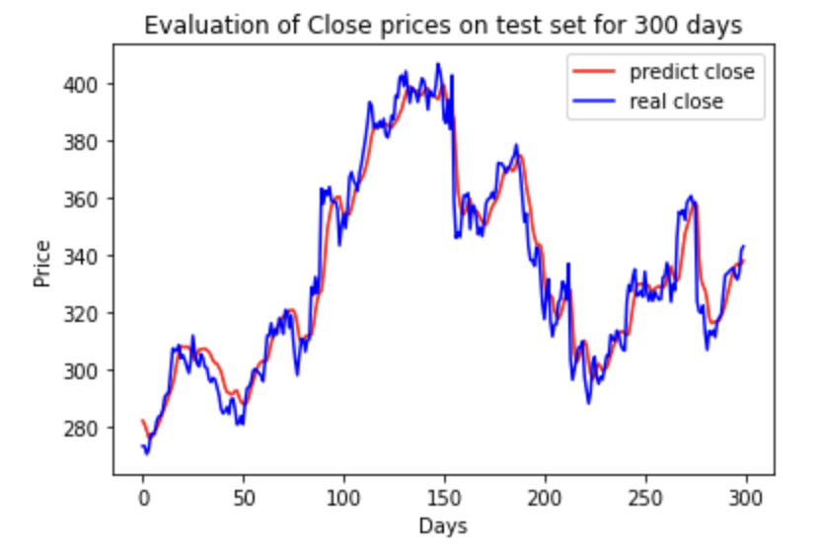
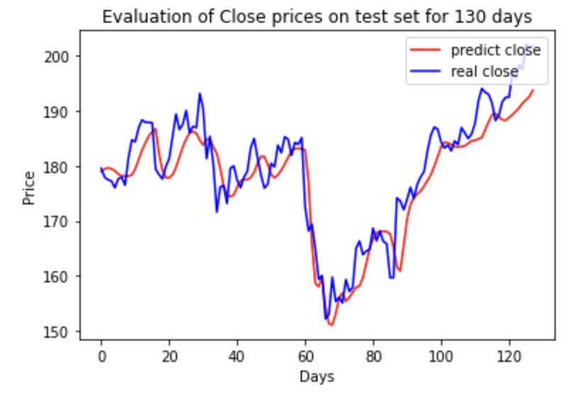
Evaluation Cont.
AAPL Stock
AMZN Stock
FB Stock

Slide 12
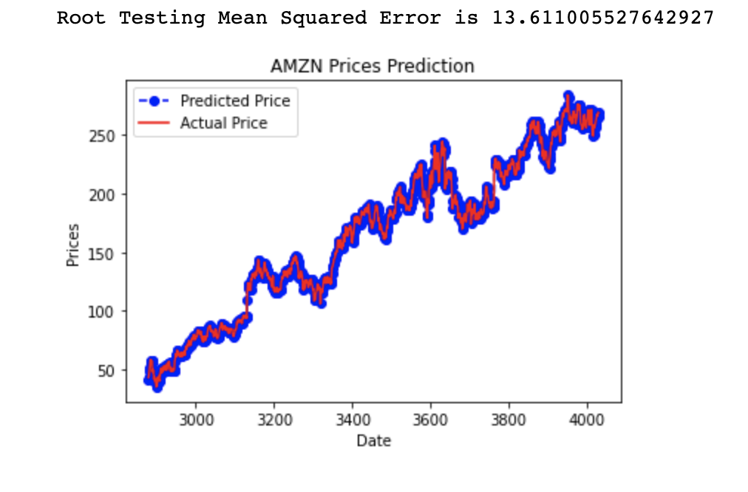
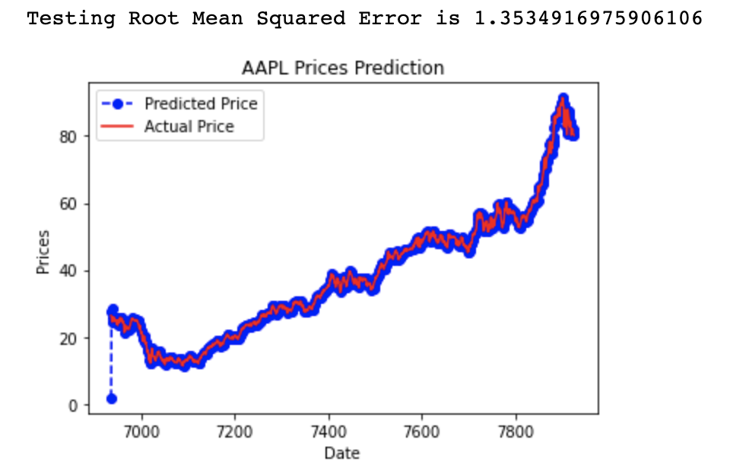
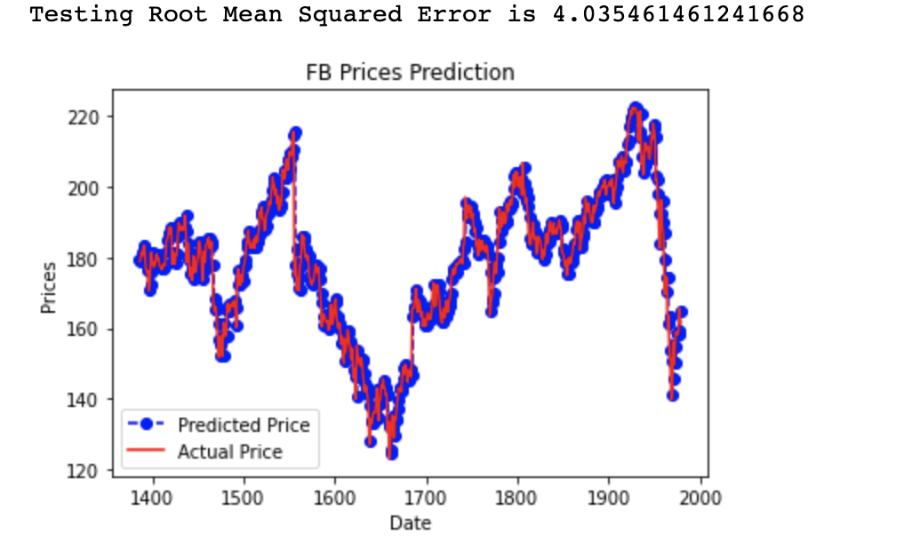
Evaluation Cont.
Comparing to ARIMA model (p=20, d=1, q=0)
 | AAPL | AMZN | FB
RMSE (stacked-LSTM) | 1.65 | 7.32 | 4.03
RMSE (ARIMA) | 1.35 | 13.6 | 4.27
Notes:
ARIMA model:The parameters (p, d, q) of ARIMA model were determined to be (1, 0, 1) based on
the MSE on the training set. This actually makes the model an ARMA model, where no differencing
was performed to change the stationarity. The MSE on the test set of Google’s data was 0.0546.
However, the model gave a linear prediction from test data, even the forecasted trend is opposite to the
real price trend. The results suggested ARIMA model did not perform well in predicting non-linearity
and long-term prediction. Hence, this model was not included in the evaluation of annual return.

Slide 13
Evaluation Cont.
Portfolio Strategy
Long-Only Strategy
Long-Short Strategy
Trading Return (AAPL)
 | Return in 10 days
Long-Only | 131%
Long-Short | 99%

Slide 14
Conclusion & Future Work
In this paper, we propose an improved stacked-LSTM and attention mechanism to predict stock price
Problems
Long-term predicting is hard
Stacked-LSTM sometimes does not have better model performance over the single LSTM model due to the potential of overfitting
Future work
Dealing with the volatility of stock time series.
One difficulty of predicting stock market arises from its non-stationary behaviour, it would be interesting to see how Attention-LSTM performs on denoised data.

Slide 15
References
S. Siami-Namini, N. Tavakoli and A. Siami Namin, "A Comparison of ARIMA and LSTM in Forecasting Time Series," 2018 17th IEEE International Conference on Machine Learning and Applications (ICMLA), Orlando, FL, 2018, pp. 1394-1401, doi: 10.1109/ICMLA.2018.00227.
Ribeiro, Antônio H, Tiels, Koen, Aguirre, Luis A, and Schön, Thomas B. "Beyond Exploding and Vanishing Gradients: Analysing RNN Training Using Attractors and Smoothness." (2019). Web.
Lipton, Zachary C, Berkowitz, John, and Elkan, Charles. "A Critical Review of Recurrent Neural Networks for Sequence Learning." (2015). Web.
Ashish Vaswani, Noam Shazeer, Niki Parmar, Jakob Uszkoreit, Llion Jones, Aidan N. Gomez, Lukasz Kaiser, Illia Polosukhin. “Attention Is All You Need.” (2017)
Sak, Hasim, Andrew W. Senior, and Françoise Beaufays. "Long short-term memory recurrent neural network architectures for large scale acoustic modeling." (2014).

